Slide 1
Constipation

Slide 2
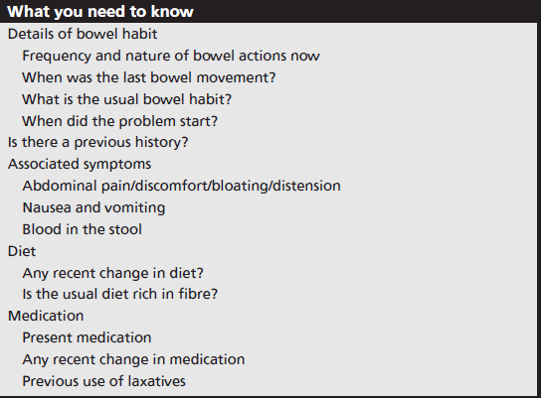

Slide 3
Constipation characterized by the passage of hard, dry stools less frequently than by the person’s normal pattern.
Details of bowel habit :normal range (1 day to three in 1week).
Associated symptoms
abdominal discomfort, bloating and nausea. In severe case as obstruction

Slide 4
Causes of constipation
Eating habits/lifestyle Most likely
Medication Likely
Irritable bowel syndrome, pregnancy, depression, functional disorders (children)
Unlikely Colorectal cancer, hypothyroidism Very unlikely

Slide 5
Specific question to ask the pt:
Pain on defecation; this is usually due to anorectal problem (hemorrhoid))
Presence of blood: must ask the pt. about blood nature (anal fissure)
Duration: more than 6 wks consider as chronic (chronic disease) . If the constipation lasts 14 days with no identifiable cause must be referral.
Life style change
Medical history.

Slide 6
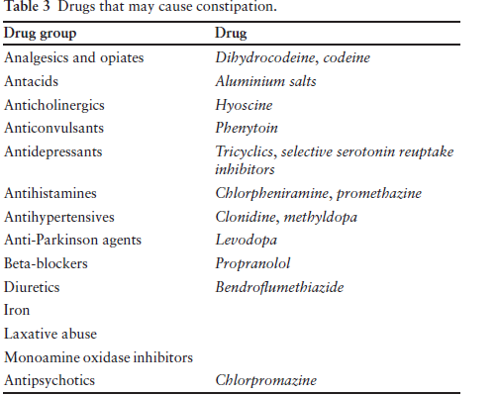

Slide 8
Management
Constipation that is not caused by serious pathology will usually respond to simple measures, which can be recommended by the pharmacist:
Increasing the amount of dietary fibre, maintaining fluid consumption and doing regular exercise. In the short term, a laxative may be recommended to ease the immediate problem.

Slide 9
Bulk laxatives
(e.g. ispaghula, methylcellulose and sterculia)
Bulk laxatives work by swelling in the gut and increasing faecal mass so that peristalsis is stimulated.
Onset: laxative effect can take several days.
Should advise that an increase in fluid intake would be necessary to avoid intestinal obstruction (particularly those whose gut is not functioning properly as a result of abuse of stimulant laxatives).

Slide 10
Stimulant laxatives
(e.g. sennosides, bisacodyl, glycerin)
Work by increasing peristalsis.
Can produce griping/cramping pains.
start at the lower end of the recommended dosage range, increasing the dose if needed.
Onset: 6–12 orally.
about 1hr Rectally
They should be used for a maximum of 1 week.

Slide 11
Bisacodyl tablets are enteric coated and should be swallowed whole because bisacodyl is irritant to the stomach. If it is given as a suppository, the effect usually occurs within 1 h and sometimes as soon as 15 min after insertion.
The use of senna pods and cascara, which is non standardised, should be discouraged because the dose and therefore action are unpredictable.
Castor oil is a traditional remedy for constipation, which is no longer recommended since there are better preparations available.

Slide 12
Osmotic laxatives
(e.g. lactulose, Epsom salts)
Lactulose works by maintaining the volume of fluid in the bowel. SE: can cause flatulence, cramps
and abdominal discomfort.
Epsom salts (magnesium sulphate) no longer. Risk of dehydration.
Glycerin suppositories have both osmotic and irritant effects and moistening the suppository before insertion.

Slide 13
Faecal softener – docusate sodium
Docusate sodium is surfactant that acts by lowering the surface
tension of the intestinal contents and allows fluid and fat to penetrate, emulsify and soften faecal material for easier elimination and avoid straining. Also exert a stimulant effect.
docusate is a weak laxative; useful for patients in whom straining at stool must be avoided, for example following an operation or myocardial infarction.
Docusate is non-absorbable and non-toxic, but it is believed to facilitate transport of other drugs across the intestine and could thereby increase their action and adverse effects.
laxative effect usually occurs within 1–3 days of administration..

Slide 14
Faecal lubricant – liquid paraffin
Liquid paraffin is the only compound available.
indigestible and minimum absorbed penetrates
and softens the faeces and coats the surface with an oily film, facilitating passage of the faeces through the intestine.
several drawbacks that make it unsuitable for regular use

Slide 15
Product selection
Pregnant and breast feeding woman
Bulk-forming laxative, Lactulose
Children
Glycerin(supp.) Lactulose
Advanced age(elderly)
Bulk-forming laxative, Also Lactulose and Glycerin (supp.) are safe.

Slide 16
Irritable bowel syndrome (IBS)
IBS is defined as a chronic, functional bowel disorder
1-Age: IBS often develop in young adult life
2-Symptoms: IBS has three Key symptoms: abdominal pain, abdominal distention/bloating and disturbance of bowel habit.
IBS tend to be episodic. The patient might have a history of being well for a number of weeks or months in between bouts of symptoms

Slide 17
Aggravating factors
Stress appears to play an important role and can precipitate and exacerbate symptoms. Also some types of food may aggravate IBS.
Pregnant women ----------- referral for further investigation
Medication: To know:
Unresponsive to appropriate treatment required referral)
Other medicines (IBS is associated with depression and anxiety in many patients

Slide 18
Treatment
Symptoms should start to improve within a week
A-Diet:
Patient with IBS should follow the recommendation for a healthy diet (low fat, low sugar, high fibre) ⁽¹⁾. In addition patient should avoid any food they know to exacerbate their symptoms ⁽¹⁾. Various foods such as beans, and fatty meals, and gas-producing foods such as
B-Antispasmodics:
Antispasmodisc are the main stay of OTC treatment of IBS. They work by a direct effect on the smooth muscle of the gut, causing relaxation and thus reducing abdominal pain.

Slide 19
1-Mebeverine
On the basis of evidence, it should be the 1st line choice (4). It is given in a dose of 135 mg three times a day, preferably 20 minutes before meals.
2-Alverine citrate (Spasmonal®): Alverine citrate is given in a dose of 60–120 mg (one or two capsules) up to three times a day (1).
3-Pippermint oil capsules:
Capsules containing 0.2 mL of the oil are taken in a dose of one or two capsules three times a day,
15–30 min before meals (1).
4-Hyoscine butylbromide(Buscopan®):
The recommended dose for adult is one tablet(10 mg) three times a day , although this can be increased to two tablets four a day if necessary (4).

Slide 20
C-Laxatives and antidiarrheals:
1-In addition , Bulk-forming and stimulant laxatives can be used to treat constipation predominant (IBS-C) (4).
2-Use of OTC antidiarrheal such as loperamide is appropriate only on an occasional, short-term basis (1).
D-Compound preparations
Bulking agents are also available in combination with antispasmodics.
e.g. Fybogel® Mebeverine: effervescent Granules (in sachets ), contain ispaghula husk (Bulk-forming laxatives) and mebeverine hydrochloride

Slide 21
Diarrhea
Diarrhea is an increased frequency of bowel evacuation with the passage of abnormally soft or watery stools .
The basis of treatment is electrolyte and fluid replacement; in addition, anti-diarrhoeals are useful in adults and older children.
It's not a disease but a sign of underlying problem or infection or GIT disorder.
It could be classified as acute( less than 7 days), chronic( more than 14 days) or persistent ( longer than a month).

Slide 22
Causes
1-Acute diarrhoea (infective diarrhoea, gastroenteritis):
Viral: Rotavirus is the most common cause of diarrhea in children under the age of 2 years.
Bacterial (food poisoning)
Antibiotics are generally unnecessary as most food-borne infections resolve spontaneously. The most important treatment is adequate fluid replacement. Antibiotics are used (by prescription only) for Shigella infections and the more severe Salmonella. Ciprofloxacin (by prescription) may be used in such circumstances.
Protozoal (amebiasis and giardiasis)

Slide 23
Significance of questions to reach diagnosis:
Age: significant care for very young ( less than 1 yr) and elderly because risk of dehydration.
Frequency: which is more than normal, also the severity of diarrhea must known.
Duration: chronic diarrhea should be referred. The causes of chronic diarrhea are -----
Recent change in diet: must ask the pt. about this
Dose any sign of dehydration present?
Associated symptoms (vomiting, abd. Cramps, present of blood or mucus)
Previous history; either medical or disease history
Recent travel

Slide 24
Conditions to eliminate:
protozoal infection,
IBS,
Medicine induced diarrhea , for ex-----------,
Ulcerative colitis,
Malabsorption syndromes

Slide 25
Management:
ORS: it has proven to be a simple highly effective treatment, which decrease mortality and morbidity ass. With acute diarrhea in developing countries
Loperamide and entero-stop ( anti-motility agents): synthetic opioid analogue, act by slowing intestinal tract time and increasing the capacity of the gut.
Dose :Loperamide: Initially 2 tablets (4 mg) followed by 1 tablet (2 mg) after each loose stool (max. 8 tablets / day). Enterostop: 4 tablets initially followed by 2 tablets every 6 hours.
Bismuth subsalicylate: no longer use because new products are present and more effective
Kaolin and pectin(adsorbant):like pectokal syr.

Slide 26
Further reading about diarrhea
1-Probiotics:
Probiotics are live microbial mixtures of bacteria (including several Lactobacillus species, lacteol forte) and yeasts used to restore the normal intestinal flora.
Probiotics have been shown to decrease the duration of infectious and antibiotic-induced diarrhea in adults and children .
2-Use of zinc in children
3- Hidra sec (racecadotril) satches 10mg oral

